Slide 1
Automated Washing Machine using PIC16F877A
Name : Shalini Sharma
Intern at : Emertxe Information PVT.LTD

Slide 2
C-PROGRAMMING
C program is used in System Software Development , Embedded Software Development , OS Kernel Development , Firmware , Middle-Ware & Driver Development.
C language is effectively used in various specific domains and it is a free-formatted language , Efficiency and portability.
Number System – Decimal , Octal , Hexadecimal , Binary.
Data representation – bit , byte , word.
Data types – Integral(char , int) , Floating point (float , double).

Slide 3
Conditional Constructs :
Single iteration – if , if-else , if else if & switch case.
Multiple iteration – While , do while , for.
Unconditional – Continue , break.

Slide 4
Learnt from Embedded C
Operators – Operates on its operands , Returns a value.
Array – Collection of data of same data type . In array Addresses are sequential.
Pointers – Parameter Passing mechanism in function , by passing the reference.
Functions – Pass by Value and Pass by reference (Return more than one value from a function) , Passing array , returning array & recursive.

Slide 5
EMBEDDED SYSTEMS
Any combination of Hardware and Software which is intended to do a Specific task is called as Embedded System.
Categories – Stand-alone-Real time , Networked , Mobile.
Challenges in ES – Efficient Inputs/outputs , Embedding an OS , Code optimization , Testing and debugging.
REAL TIME ASPECTS :
Hard Real Time – It should meet its deadline Life Critical Application.
Firm Real Time – Similar to Hard Real Time.
Soft Real Time – It can have tolerance in meeting its deadline.

Slide 6
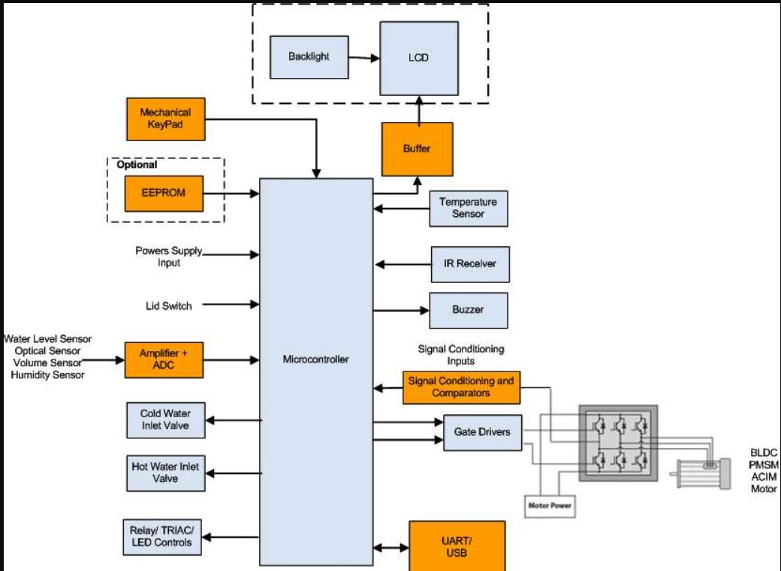
Block Diagram of Washing Machine

Slide 7
CLCD 8 bit and 4 bit mode.
CLCD stands for character liquid crystal display.
It has two type of displays 16*2 and 16*4.
In our project we used 16*4 display.
It has total 16 interfacing lines.
D0 to D7 are data lines , it has build in controller it has its own ROM and RAM that controller can execute the instruction and data.
RS Line –register select line.
Rs value 1 - data
Rs value 0 – instruction.
Data processed by two methods-delay method and polling method.
In CLCD D0 to D7 are connected to port D & Rs and enable pin are connected to port E.
8 bit mode – D0 to D7.
4 bit mode D4 to D7.

Slide 8
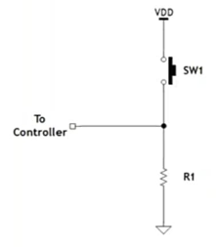
Tactile Key
A tactile switch allows electricity to flow in an electrical circuit by manually pressing the operating section. The switch is used to supply input signal to activate a device.
The switch activates when pressed and then turns off when released
There are many different types of tactile switches such as tactile pull up an pull down.

Slide 9
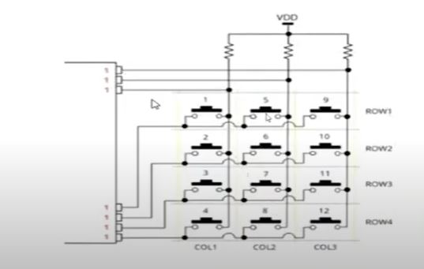
TACTILE KEYPAD IN MATRIX KEY PAD.

Slide 10
TIMERS
There are three types of timers in PIC16F877A microcontroller timer-0,timer-1 timer-2.
Timer can work as timer and controller like for counting internal pulses and external pulses.
Timer 0 is a 8 bit timer like it will count from 00 to ff then generate a interrupt.
There are various registers associated with timer 0 like TMR0 clock source select bit.
There are 15 interrupt sources in case of this microcontroller.
Timer 0 has a bit GIE if we set this bit it will enable all the interrupts.
GIE bit is common for all the function whether main.c or timer.c.

Slide 11
Software Used
MPLAB X IDE –
MPLAB is a proprietary freeware integrated development environment for the development of embedded application on PIC & dsPIC controllers , and is developed by Microchip Technology.
PicSimLab simulator –
PicSimLab is a Realtime emulator of development boards with integrated MPLABX/avr-gdb debugger. PicSimLab supports some picsim microcontroller.

Slide 12
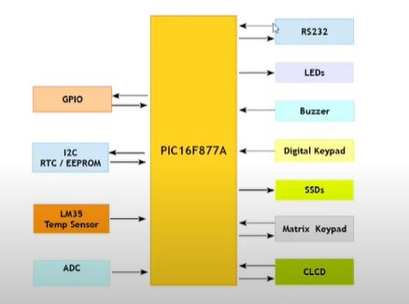
PicSimLab Architecture

Slide 13
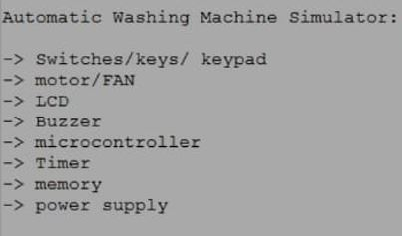
IMPLEMENTATION

Slide 14
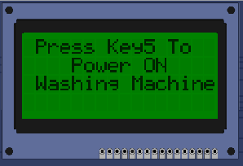
IMPLEMENTATION
STEP 1 :
To turn on the washing machine user have to press Key 5 i.e. RB4

Slide 15
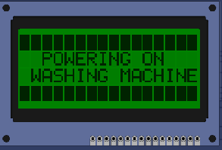
Step 2 :
Power on screen with 3s delay.

Slide 16
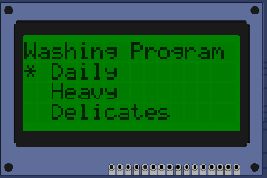
Step 3 :
Washing programs shows the different types of cloths which user want to wash like
Daily ,Heavy, Delicates, whites, stain wash, Eco cotton ,Woollens ,Bedsheets ,Rinse + Dry ,Dry only ,Wash only & aqua store
To select one of these user have to Long press RB3

Slide 17
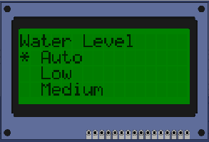
Step 4 :
This screen indicates different levels of water flow in the machine
Like Auto, Low, medium, High & Max
To select one of these user have to Long press RB3

Slide 18
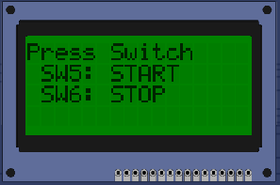
Step 5 :
This step gets user acknowledgement to start or stop the process
RB4 – Start & RB5 – Stop

Slide 19
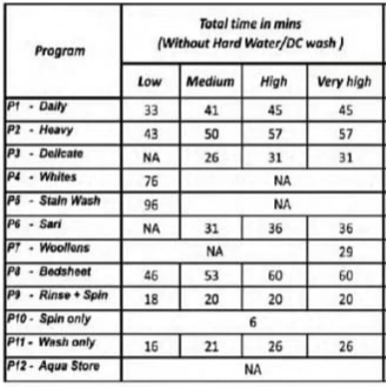
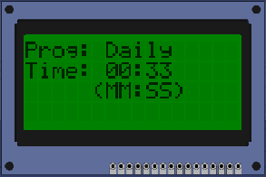
Step 6 :
This screen shows the users choice of
cloth type and time in MM:SS format.

Slide 20
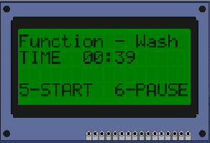
Step 7 :
This screen shows the process like Wash , Rinse , Spin and Dry
Time, start and pause options.

Slide 21
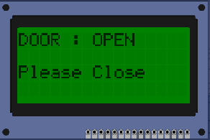
At the time of washing if user opens the door by pressing RB0 this above screen will pop.

Slide 22
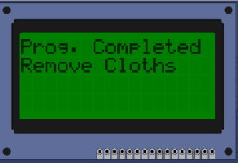
Step 8 :
After all the process done washing machine displays the following screen.

